Slide 1
Proposal for Spacecraft Light Curve Analysis
Kent Rush

Slide 2
Introduction and Background

Slide 3
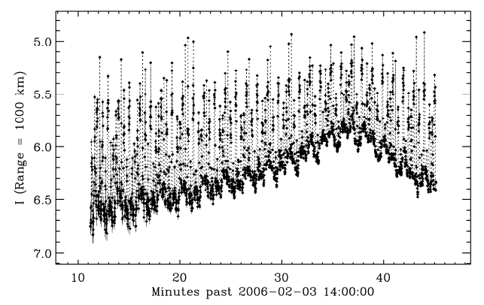
What is a Light Curve

Slide 4
Origins of Light Curve Analysis

Slide 5
Synodic Period Estimation

Slide 6
Sidereal Period Estimation

Slide 7
Light Curve Inversion

Slide 8
Phase-Angle-Brightness Plots

Slide 9
Kalman Filtering

Slide 10
My Thesis

Slide 11
Motivation

Slide 12
Important Questions that Remain Unanswered
Debris Removal
National Security
Operations
How fast is this spacecraft spinning?
In what way is this spacecraft spinning?
Is this spacecraft pointing at targets of significance to national security?
Is my spacecraft behaving as expected?
Is my spacecraft under control?

Slide 13
Is this new?

Slide 14
Yes

Slide 15
Scope

Slide 16
Goals
Develop a formulation of the Unscented Kalman Filter
Develop a higher fidelity reflectance model
Deploy UKF and reflectance model to real data

Slide 17
Methodology

Slide 18
Kalman Filter Formulation

Slide 19
Reflectance Model

Slide 20
Application to Real Data

Slide 21
Verification

Slide 22
Analysis Plan

Slide 23
Minimum Criteria
Develop an Unscented Kalman Filter that can estimate attitude and angular velocity to a useful degree.
Apply UKF to real data.
If application to real data fails, determine the quality of data that would enable this method of analysis.

Slide 24
Proving Results
For testing against simulated data, a truth model of the spacecrafts attitude and angular velocity will be simulated to compare against. A light curve will be generated from this model with noise added. A positive result using this data would show the UKF state estimate of angular velocity and attitude converging on the same values as the truth model.
For real data, proving the results is not possible for most cases. However, data can be analyzed for spacecraft in known orientation and spin states. A positive from these known spacecraft would show the estimated attitude and angular velocity matching published values.

Slide 25
Schedule

Slide 26
Schedule
Fall Quarter |  |  |  |  | Winter Quarter |  |  |  |  | Spring Quarter
Wk 1-2 | Wk 3-4 | Wk 5-6 | Wk 7-8 | Wk 9-10 | Wk 1-2 | Wk 3-4 | Wk 5-6 | Wk 7-8 | Wk 9-10 | Wk 1-2 | Wk 3-4 | Wk 5-6 | Wk 7-8 | Wk 9-10
Literature Review |  |  | Proposal |  |  | Prep Seminar | Seminar | Write Thesis |  |  |  | Defense | Relax
 | Develop UKF Formulation |  |  |  | Develop “Ray Tracing” BRDF simulation |  |  | Buffer time |  |  |  |  | Buffer Time
 |  |  | Develop accurate Truth Simulation |  |  | Verify in Simulation |  | Analyze Real Data

Slide 27
Challenges

Slide 28
Challenges by parts
Unscented Kalman Filter
“Ray Tracing” BDRF Model
Using Real Data
Most states that we are interested in measuring are only indirectly related to the measurement. A very accurate model is needed remove ambiguities in the data. Additionally the formulation should only require inputs that are usually available.
Complex algorithm and outside of my own experience. Potentially needs to be written in C++ and interfaced with my Python scripts to increase computation speed. I can do it, but I cannot afford to get hung up on this.
Simulated data can be as pristine and plentiful as is necessary for my UKF formulation to work. Real data is messy, filled with holes, and scarce. A method of augmenting data or combining data from multiple passes may be required.

